Slide 1
GitHub Overview
create your 6 figure developer portfolio today

Slide 2
Why git?
Current industry standard for collaborative and remote development
Employers want to see an active github account
Your github page = your programmer portfolio
Want to build up your resume? Try contributing to an open source project!

Slide 3
Getting Started
Create your first repo on github.com
Use GUIs to work with git in the beginning
GitHub Desktop, VS Code, your IDE, etc.
Looking for more? Consider learning the command line

Slide 4
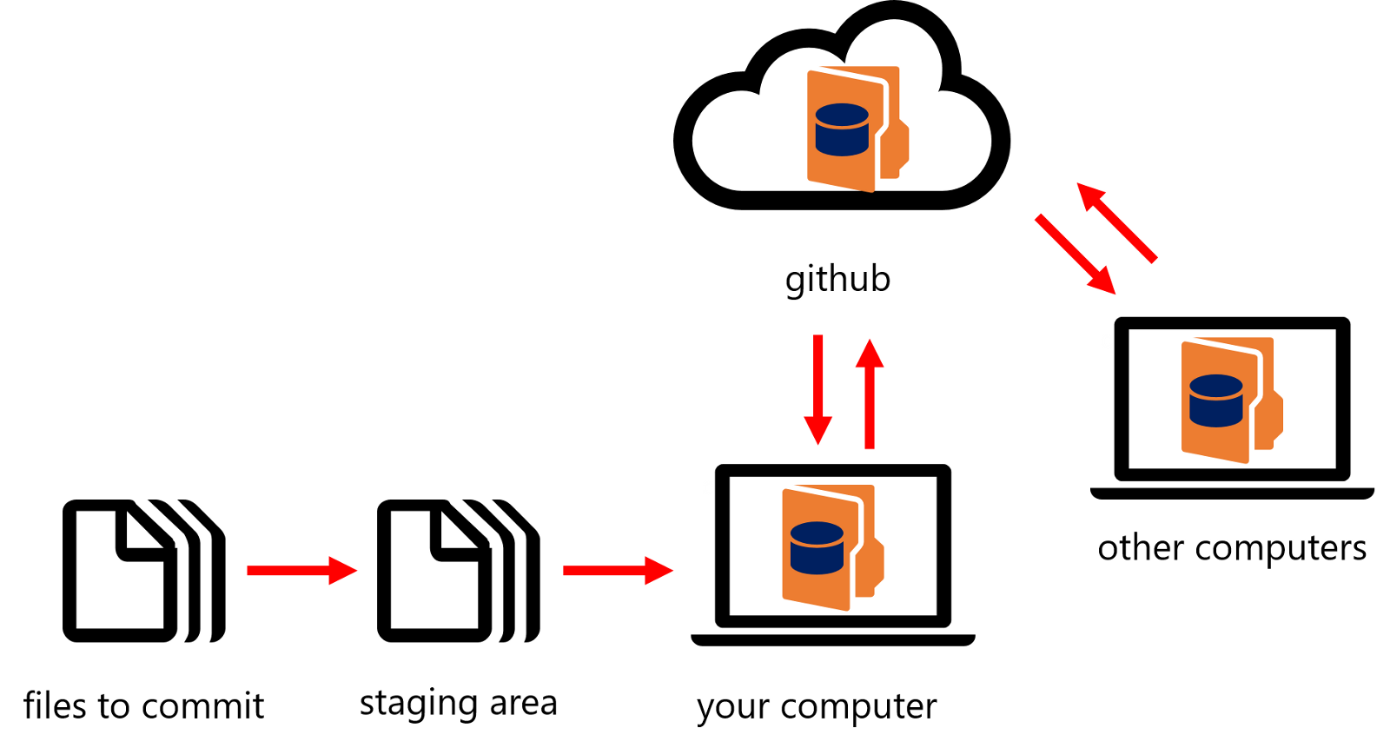
Git Lifecycle Overview
GitHub.com
(Remote cloud)
Your Team (Collaborators)
Your Computer (Local)
Notes:
https://medium.com/@abhishekj/an-intro-to-git-and-github-1a0e2c7e3a2f

Slide 5
Key Terms: Working Solo
create & init a repo (remote - easiest thru github.com web site)
clone a repo (local)
download a repo to your local computer so you can edit & work on it
you can also make small changes directly through the github web site
add a file to your repo (local) begin tracking a new file
commit your changes (local)
tell git you want to keep your changes (like hitting “save” button)
push your changes (local → remote)
share your changes with others (or your future self) in the cloud

Slide 6
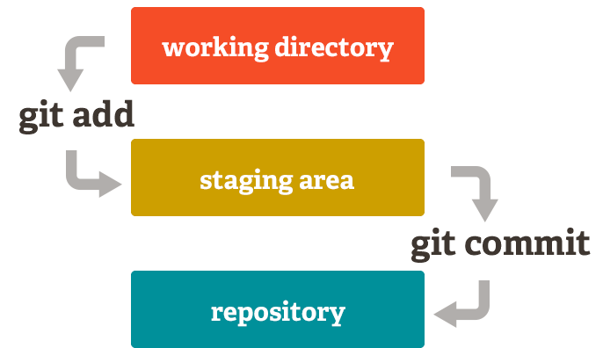
Adding a new file (local)
local
Notes:
Adapted from http://dh.newtfire.org/explainGitShell.html

Slide 7
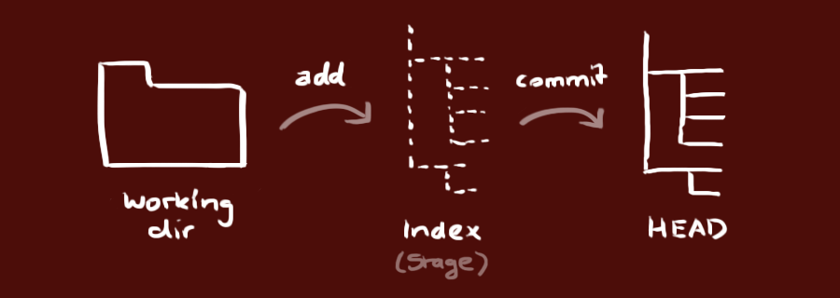
Adding a new file (local)

Slide 8
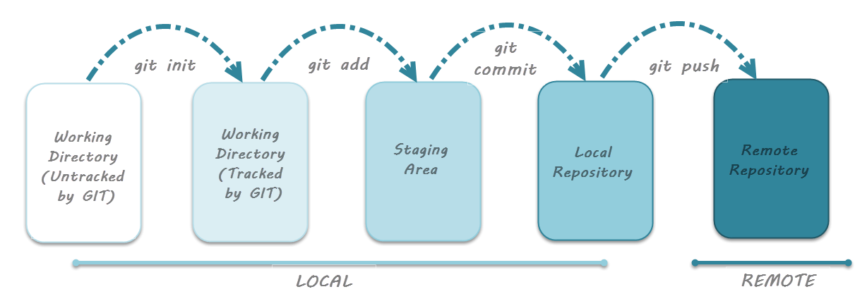
Git Lifecycle Overview
Notes:
https://www.toolsqa.com/git/git-life-cycle/

Slide 9
Key Terms: Working on a Team
pull collaborator changes (remote → local)
FIRST DEV STEP whenever you restart working on a team project
won’t work unless you commit first!
ensures you don’t overwrite any edits
fork a repo (remote)
create a copy of a repo you don’t own so you can edit it through your profile
pull request (remote)
propose a change to the owner of a forked repo
branch
separate development stream for features / team members
master: the main branch

Slide 10
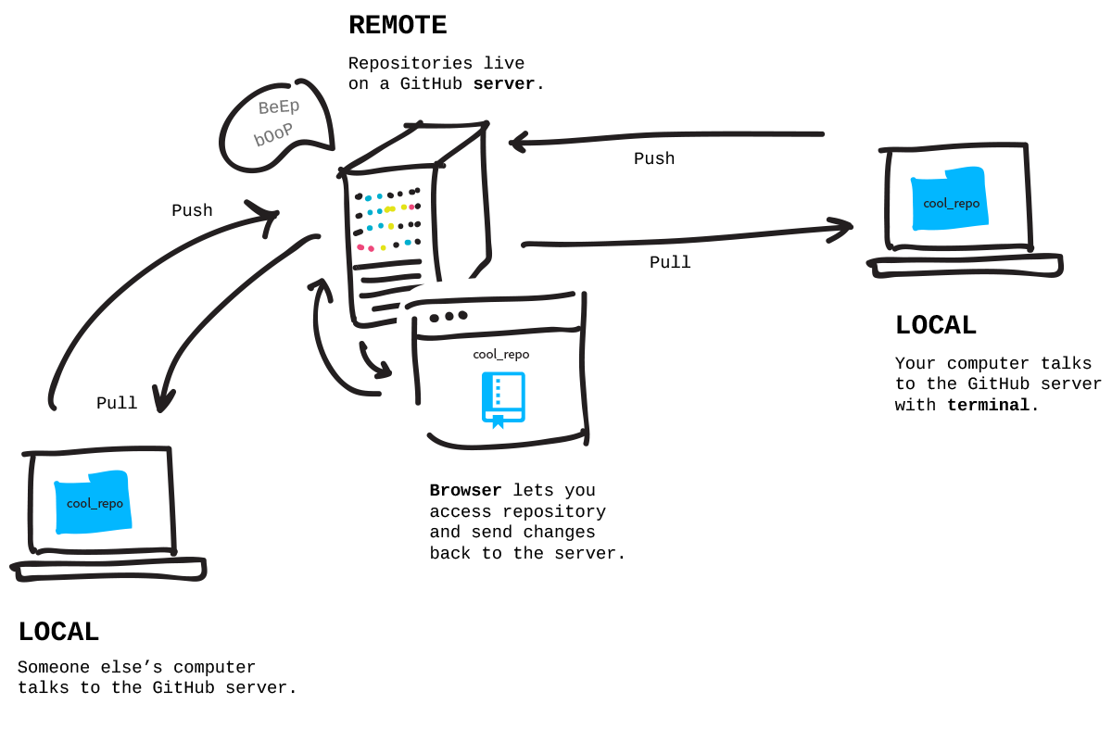
Sharing that file with others
Notes:
https://www.zentao.pm/share/git-sync-remote-repos-update-179.html

Slide 11
Collaborative Git Workflow
(Assuming you’ve cloned a repo)
Pull
Make changes
Commit (& pull if repo has changed since last)
Push
Collaborators can then see & pull your changes into their local copies
Notes:
http://rogerdudler.github.io/git-guide/
Making changes:
- commit
- push
- pull from upstream
- resolve conflicts if necessary
- make pull request
Getting changes:
- pull upstream (or master)
- first time, import into workspace but DON’T copy files
- changes thereafter will be reflected after refreshing

Slide 12
Next Steps
Create a github repo for your portfolio project!
Get it connected to your dev environment (see tutorial)

Slide 13
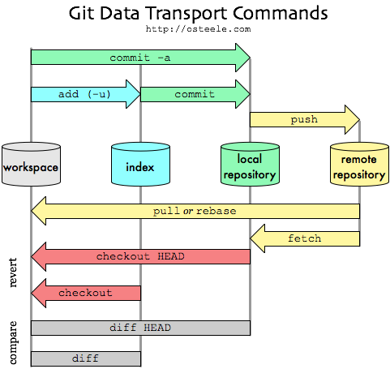
Notes:
https://blog.osteele.com/2008/05/my-git-workflow/

Slide 14
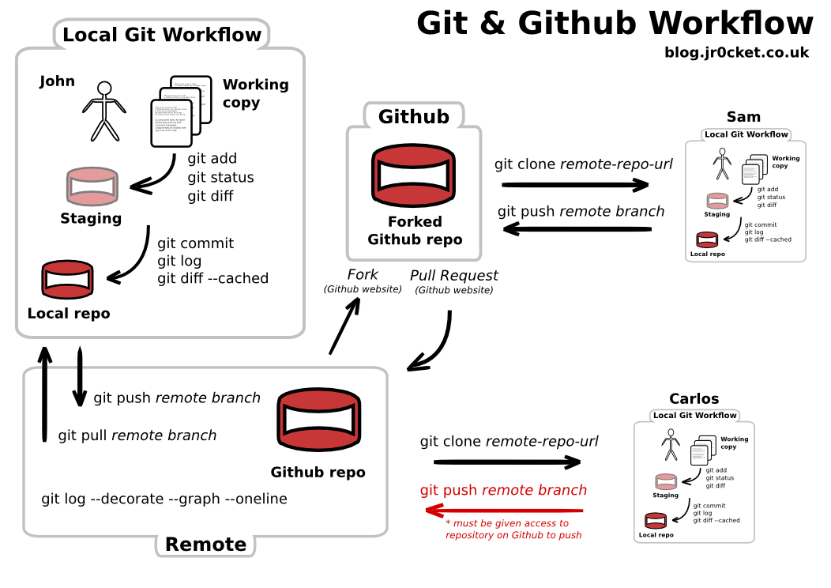
Notes:
http://jr0cket.co.uk/2013/08/getting-to-grips-with-git-understanding-the-simple-workflow.html.html

Slide 15
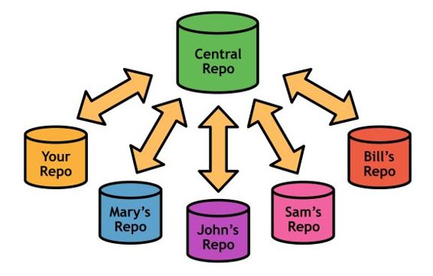
Making changes in teams
(Assuming you’ve cloned your team’s repo)
Stage changes in your working copy
Commit
Pull from upstream
resolve conflicts if necessary
Push
Make pull request to remote repo (if you don’t have commit privileges)

Slide 16
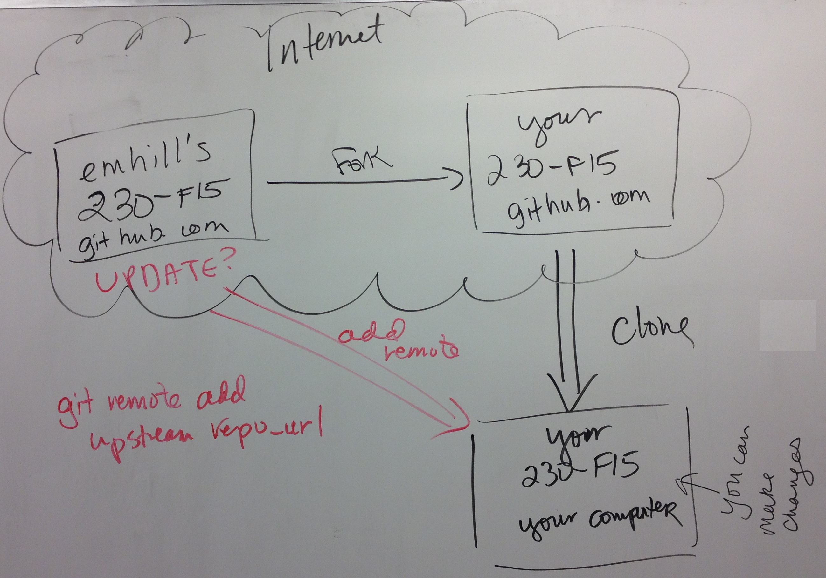
Forking, Cloning, & Remotes
Notes:
http://byteblink.com/blog/2013/10/26/setting-up-git-with-sourcetree-and-a-remote-dreamhost-repository-on-mac-osx-part-2
https://help.github.com/articles/fork-a-repo/
http://stackoverflow.com/questions/9257533/what-is-the-difference-between-origin-and-upstream-in-github/9257901#9257901
http://www.eqqon.com/index.php/Collaborative_Github_Workflow

Slide 17
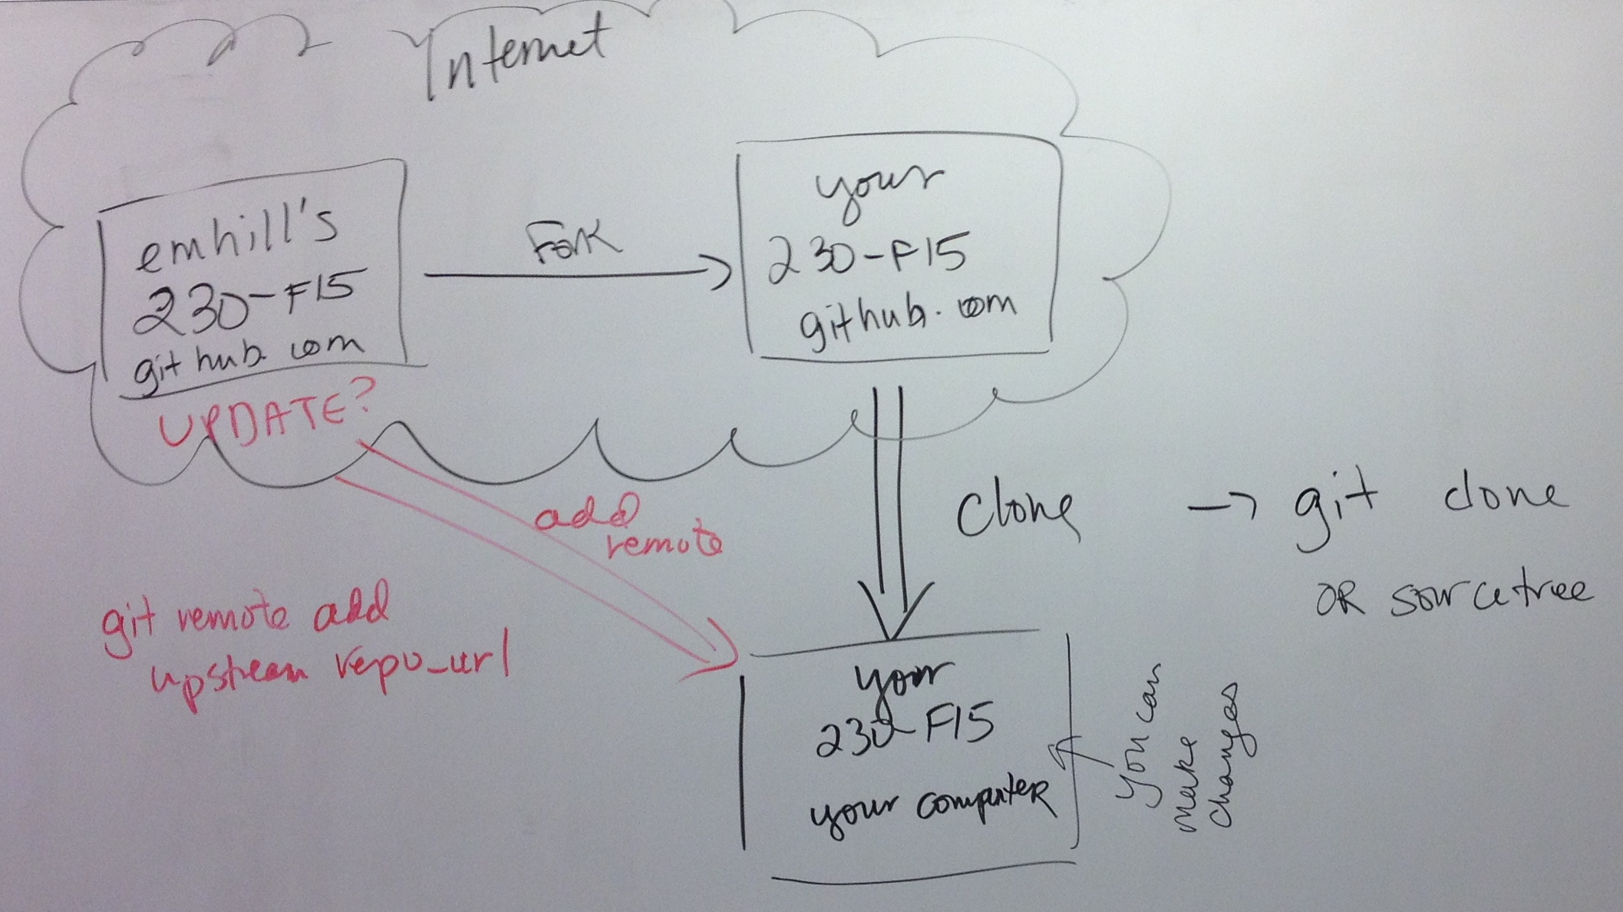
Forking, Cloning, & Remotes
Notes:
http://byteblink.com/blog/2013/10/26/setting-up-git-with-sourcetree-and-a-remote-dreamhost-repository-on-mac-osx-part-2
https://help.github.com/articles/fork-a-repo/
http://stackoverflow.com/questions/9257533/what-is-the-difference-between-origin-and-upstream-in-github/9257901#9257901
http://www.eqqon.com/index.php/Collaborative_Github_Workflow

Slide 18
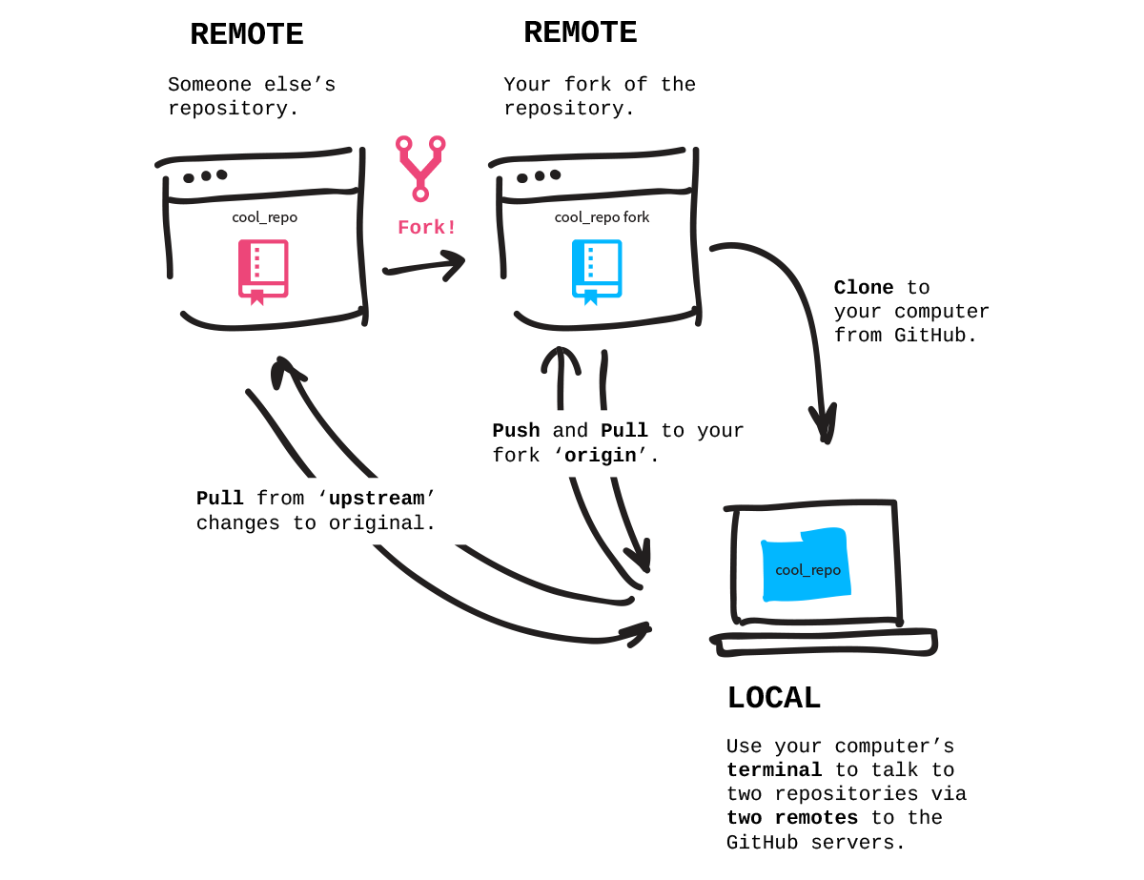
Notes:
http://jlord.us/git-it/assets/imgs/clone.png

Slide 19
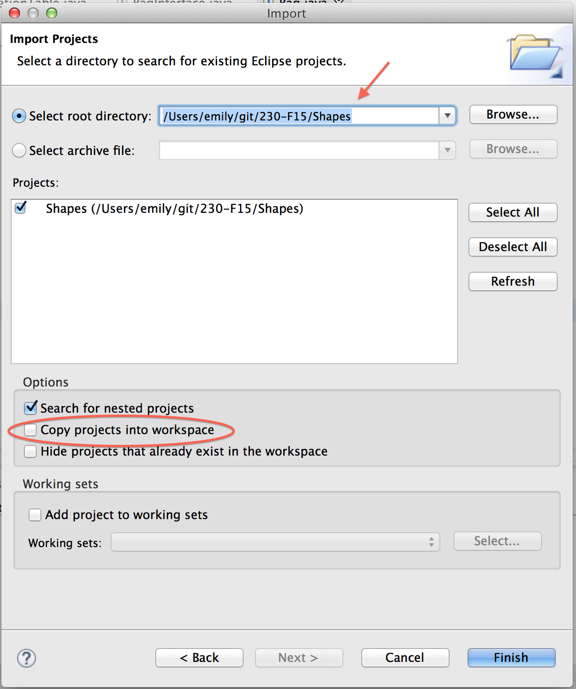
Getting changes into eclipse
Clone repo
First time only, import into workspace but DON’T copy files
Pull upstream (or master)
Changes hereafter will be reflected in eclipse workspace after refreshing

Slide 20
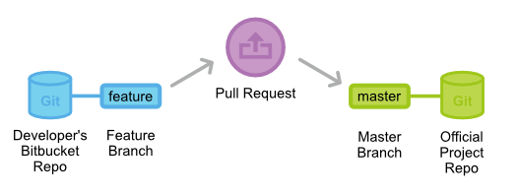
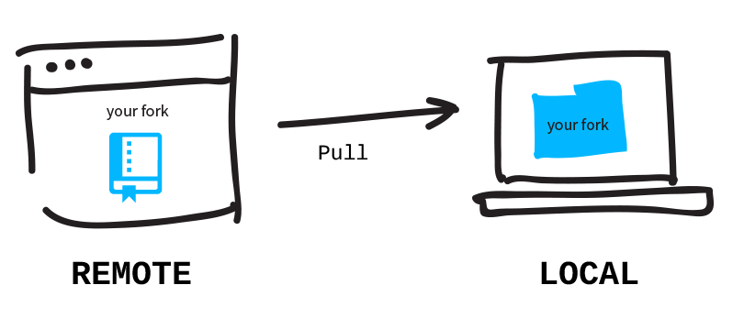
Pull requests
Allow you to merge into a forked repo where you are not the owner or a collaborator
Not to be confused with pulling from a remote repo into your own local copy:
Notes:
Bitbucket is another place to host git repos
https://www.atlassian.com/zh/git/workflows#!pull-request

Slide 21
Notes:
If you liked this video & would like to see more, please post your questions & topics below! Thanks for watching!

